Slide 1
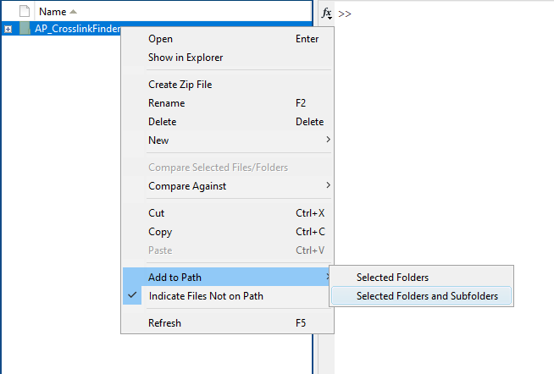
Instruction of AP_CrosslinkFinder
Jin Tang, Linlin Zhao
University of California, Riverside
1. Open MATLAB, add AP_CrosslinFinder folder to path

Slide 2
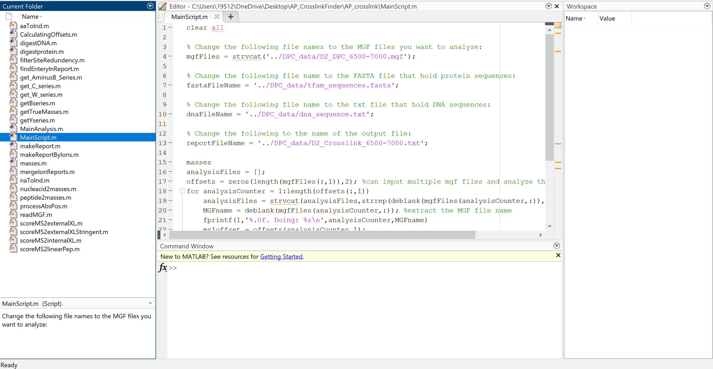
2. Go to \AP_crosslink_matlab\AP_CrosslinkFinder\AP_crosslink and open MainScript.m
Change the file name
The input MS data must be the MGF files, separate the files with coma, you can input multiple MGF files at once, but each MGF file cannot be too large.
Convert raw file to MGF file with MSConvert (proteowizard)

Slide 3
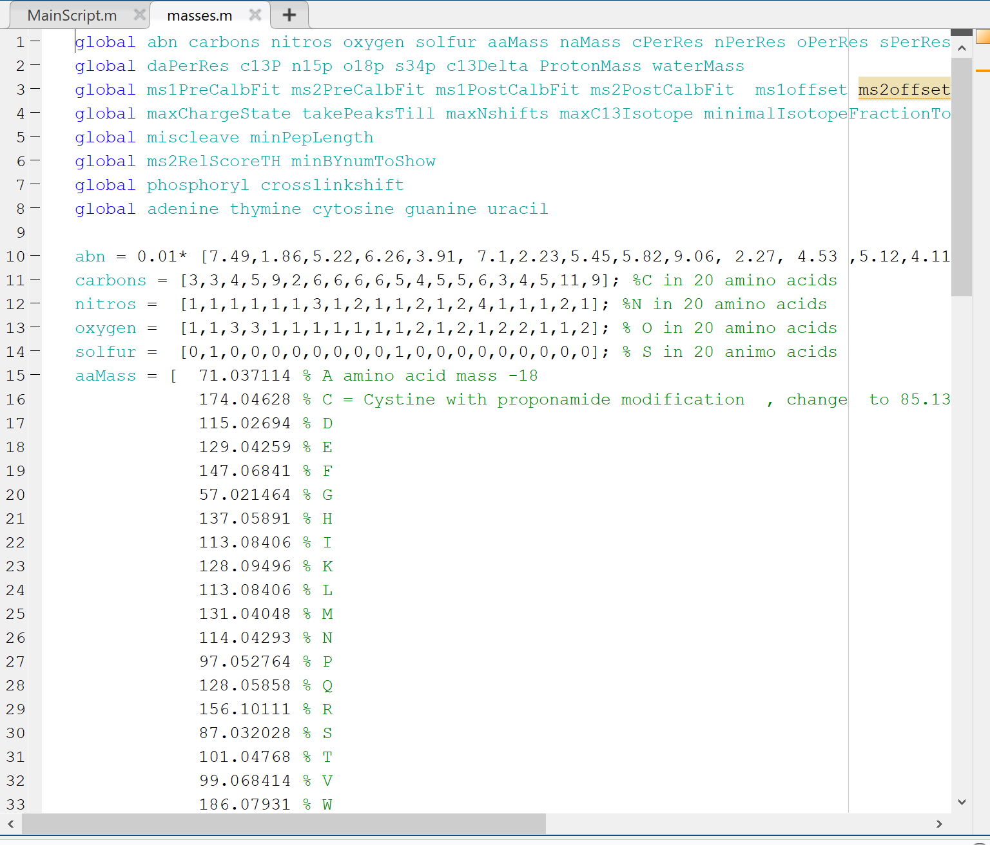
3. The example files are stored in the DPC_data folder and you could press “Run” to start the analysis
The DNA sequence needs to input as the base+P such as “APTPCPGP” to indicate the DNA sequence of “ATCG” with 3’ phosphate. Mark the AP sites with “X”. (The example DNA sequence is the sequence of D2.
The deoxynucleotides are “ATCGX”, the ribonucleosides are “aucgx”, between each nucleoside, add a P. If the 3’ or 5’ side of the DNA/RNA sequence doesn’t contain phosphate group, don’t add P before or after the sequence.
4. If you have used other non-canonical nucleic acids or amino acids, modify the mass list in masses.m
“aaMass” is the mass of amino acid minus water mass
“naMass” is the mass of nucleic acid minus water
“crosslinkshift” is the formation of crosslink caused the net mass shift of the DNA and protein (decrease), if you have used the chemical crosslinker and caused the mass increase, this number should be negative.

Slide 4
5. The major script is in the MainAnalysis.m, more detailed information are stored in here.
6. The MGF file is read with readMGF.m
To ensure the script running, check the content in MGF file
For example
BEGIN IONSTITLE=20210422-012.6500.6500.2 File:"20210422-012.raw", NativeID:"controllerType=0 controllerNumber=1 scan=6500"RTINSECONDS=2245.167059PEPMASS=448.740661621094 877459.589233399951CHARGE=2+125.988121 332.4971618652
…….
END IONS
The format of your MGF file should be similar to the example, or you need to modify the script in the readMGF.m to correctly read MGF file.
7. The calculation of the Mw of the crosslinked species is
mass = peptide mass + DNA mass – crosslinkshift

Slide 5
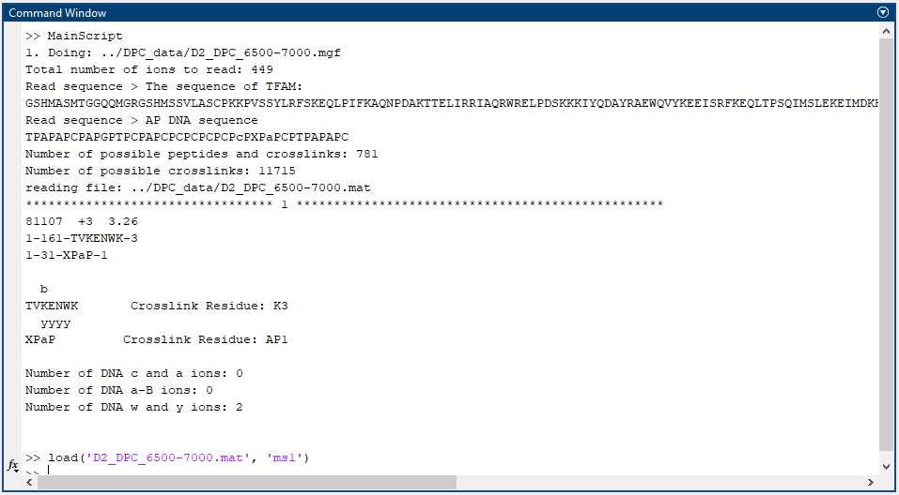
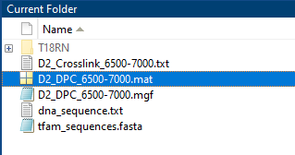
8. The output of the program should be
The command window will show part of the crosslinks and so as the output txt file.
However, to accurately assign the crosslinks, you need to open the .mat file, which has the same name as the MGF file.
9. Find .mat file in DPC_data folder, double click to open it

Slide 6
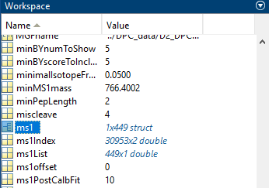
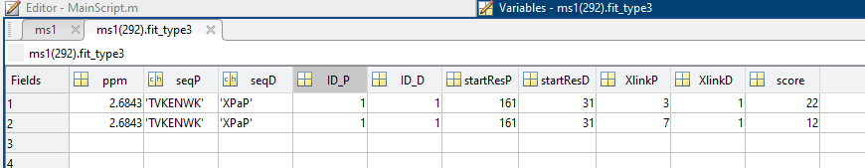
10. Find “ms1” in workspace, double click to open
Open ms1, on the right side, there are fit_type1, fit_type2 and fit_type3, and they are representing the peptides, peptide-peptide crosslinks and peptide-DNA crosslinks, respectively. When the program couldn’t find any matches, it outputs “[]”. When some matches are found, it outputs “n×n struct”, n is a number.
You can find the scan number in ms1 and look into the spectra in Xcalibur.
11. If you double click the “n×n struct”, it displays
The score indicates how many fragment ions in MS2 matches the ions in the list of theoretical fragment ions, the larger the score the more likely the sequence is correct. “XlinkP” indicates the location of the cross-linked amino acid residue on the cross-linked peptide, “3” means the cross-linked amino acid is the third one in the sequence, so it is the first “K” in this example. “XlinkD” indicates the location of the crosslinked nucleic acid residue on the cross-linked oligonucleotide, “1” means it cross-linked at the first nucleic acid residue, which is “X” in this example.
Check the MS/MS spectrum in Xcalibur to confirm the identification.

Slide 7
12. The AP_CrosslinkFinder is modified based on the Find_XL package that is designed for searching the peptide-peptide crosslinks from the Kalisman group.
Reference:
Kalisman, N.; Adams, C. M.; Levitt, M. Subunit Order of Eukaryotic TRiC/CCT Chaperonin by Cross-Linking, Mass Spectrometry, and Combinatorial Homology Modeling. Proc. Natl. Acad. Sci. 2012, 109 (8), 2884–2889.

